Slide 1
IoT device gestation, LA1, Projects
— SA-DF-HE
COM3505, Lecture 7
Prof Hamish Cunningham

Slide 2
COM3505 2022 — Part 2
Congrats, you’ve (almost) made it half way!
The rest of the course:
starts with Lab Assessment 1 (LA1), a threshold test due Friday
then covers a bit more theory
prepares for the exam (mock exam available from week 9/10)
lets you loose on the project :)
subject of the second lab assessment due week 12
a vehicle for your portfolio
today we will...

Slide 3
Lecture 7
start with LA1, skip to L8/projects, if time do unPhone assembly demo and maybe more bits of L7
Contents
interrupts and timers
lab assessment 1: build a Pr[ovisioning]AndUpd[ate]Thing
projects: Marvin, unPhone, LilyGoWatch, or…?
creating a new IoT device

Slide 4
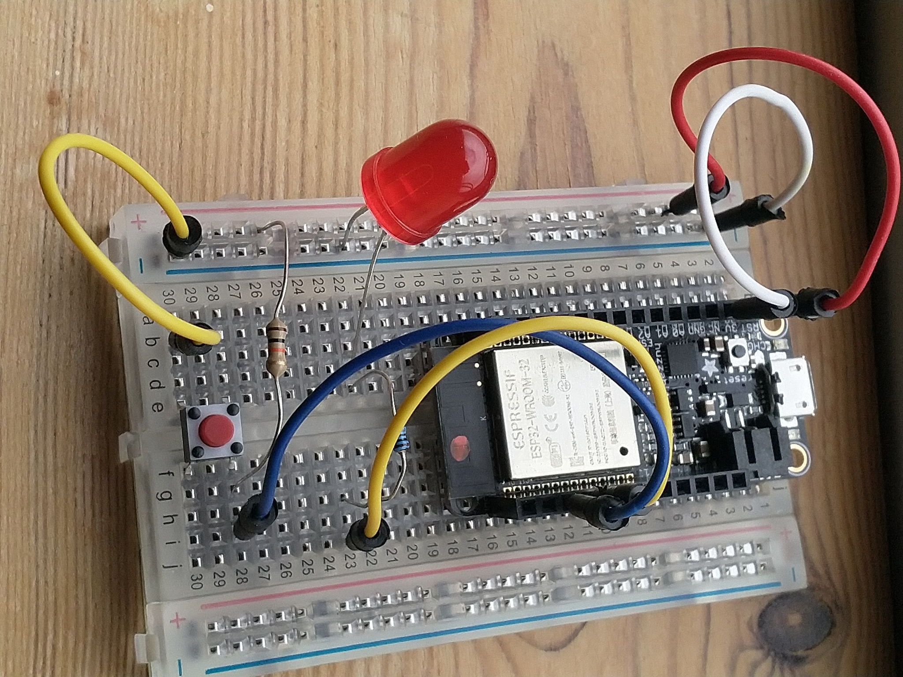
Timers and Interrupts: TimingThing
background: multiprocessing vs. MCU/RTOS
the two ESP32 cores mean we can do a little multiprocessing, though one core is mostly for protocols, WiFi, …
RTOS tasks allow both hardware interrupts and timer/resume
an example board: one switch, one LED (gotcha: a floating switch triggers interrupts continuously, so use a bias resistor, e.g. pullup to V+)
simplified.ino: the digitalRead/delay approach
problem: what if the switch press comes during the delay?
interrupts: let the electronics do the work, attach handler to pin
sketch.ino; IRAM_ATTR; safety in ISRs; Andreas’ video
see also the course notes, section 7.1
should I use it? in the long run yes; for small examples you can get away with simpler methods

Slide 5
TimingThing (2)
// sketch.ino: an example of using interrupts
#include <Arduino.h>
uint8_t SWITCH_PIN = 14, LED_PIN = 32; // which GPIO we're using
static void eventsSetup(); // declare interrupts config routine
static bool flashTheLED = false; // when true flash the external LED
void setup() {
Serial.begin(115200);
printf("\nahem, hello world\n");
pinMode(LED_PIN, OUTPUT); // set up LED pin as a digital output
eventsSetup(); // deal with interrupt events
} // setup
…

Slide 6
TimingThing (3): interrupt on switch, delay on LED
void loop() {
if(flashTheLED) {
Serial.printf("setting 32 HIGH...\n");
digitalWrite(LED_PIN, HIGH); // on...
delay(500); // how would you avoid this?
Serial.printf("setting 32 LOW...\n");
digitalWrite(LED_PIN, LOW); // off...
delay(500); // hint: see chapter 7 on timers :)
}
} // loop
// gpio interrupt events
static void IRAM_ATTR gpio_isr_handler(void *arg) { // switch press handler
uint32_t gpio_num = (uint32_t) arg;
flashTheLED = ! flashTheLED; // toggle LED flash state
}

Slide 7
TimingThing (4)
static void eventsSetup() {
// configure the switch pin (INPUT, falling edge interrupts)
// uses the IDF API to configure GPIO
gpio_config_t io_conf; // params for switches
io_conf.mode = GPIO_MODE_INPUT; // set as input mode
io_conf.pin_bit_mask = 1ULL << SWITCH_PIN; // bit mask of pin(s) to set
io_conf.pull_up_en = GPIO_PULLUP_ENABLE; // enable pull-up mode
io_conf.pull_down_en = GPIO_PULLDOWN_DISABLE; // disable pull-down mode
io_conf.intr_type = GPIO_INTR_NEGEDGE; // interrupt on falling edge
(void) gpio_config(&io_conf); // do the configuration
// install gpio isr service & hook up isr handlers
gpio_install_isr_service(0); // prints an error if already there; ignore!
gpio_isr_handler_add( // attach the handler
(gpio_num_t) SWITCH_PIN, gpio_isr_handler, (void *) SWITCH_PIN
);
}

Slide 8
Lecture 7
Contents
interrupts and timers
lab assessment 1: build a PrUpdThing
projects: Marvin, unPhone, LilyGoWatch, or…?
creating a new IoT device

Slide 9
LA1: PrUpdThing
build a breadboard with the ESP32S3 and some LEDs connected to GPIO pins
implement provisioning and OTA update on the ESP (e.g. via Ex09 and Ex10)
light the LEDs to indicate the stage of processing
document it in depth and in detail! see LA1/rubric.mkd in your repo
push it to your gitlab repo in a directory called LA1/PrUpdThing at the top level; use the README.mkd for your docs and PrAndUpThing/PrAndUpThing.ino for your code
optional extra: manage the process with touch sensing
deadline: Fri March 22nd marks: 20%, pass/fail; size: ~8 hours

Slide 10
LA1: PrUpdThing (contd.)
bottom line: if it works, does the basics, and you’ve told me how, you’ll pass
optionally: you can also use this as a larger trial-run for the project, explore the subject in some depth and come up with a polished solution
both approaches are fine :)

Slide 11
Lecture 7
Contents
interrupts and timers
lab assessment 1: build a PrUpdThing
projects: Marvin/Willow, unPhone, LilyGoWatch, or…?
creating a new IoT device

Slide 12
Projects: Marvin, unPhone, LilyGoWatch, or…?
options:
the unPhone
Marvin, a DIY Alexa, or ESP-Box/Willow
LilyGoWatch
roll your own (but check first!)
the spin 9 unPhone is an ESP32S3, LCD with touch display, accelerometer, SD card, LoRaWAN, IR LEDs and vibe motor
possible unPhone projects: meshtastic off-grid messaging; remote control of other devices over WiFi or BT, perhaps using a gesture language; voice control via a mic on your other ESP32 (or the expander); exercise tracker; data logger; small-screen UI; fuzzy predictive text; TV-B-Gone, TV remote, battleships, Meshtastic, Robocar controller, step counter, GPS campus alarm etc. etc. etc.…
with Marvin or ESP-Box and/or the ML that Valentin introduced last week, lots of Alexa-type projects :)

Slide 13
Projects: pros and cons
Project | Advantages | Disadvantages
unPhone | all the elements are pre-soldered (unless you use the expander board) there’s a UI! lots of variations possible | it looks like a phone but… isn’t! relies on patched libraries which can make development (even) trickier (v9 better tho)
Marvin or ESP-Box | close to mass-market products like Alexa, Google Home, etc. good online supporting resources | Marvin version needs wiring noise and voice dependent relies on 3rd party services
LilyGO Watch | a wearable! carry a memento of COM3505 everywhere you go! | not a smart watch! translation of docs not perfect
A.N.Other | creativity! | you need to be sure it is A) feasible and B) hard enough

Slide 14
LiPo: handle and charge carefully
The unPhone contains a Lithium Polymer (LiPo) battery; treat it carefully!
These are potentially dangerous: sign the disclaimer, read the notes — https://iot.unphone.net/#lipo-safety, if in doubt ask!
The two main issues:
handling (don’t break the containment)
charging (the PMU / battery management chip and its programming have been verified by qualified engineers at Adafruit and Pimoroni, but that doesn’t mean they’re infallible, and there is potential for us to break it… take care!)

Slide 15
Lecture 7
Contents
interrupts and timers
lab assessment 1: build a PrUpdThing
projects: smartwatch in the post!
creating a new IoT device

Slide 16
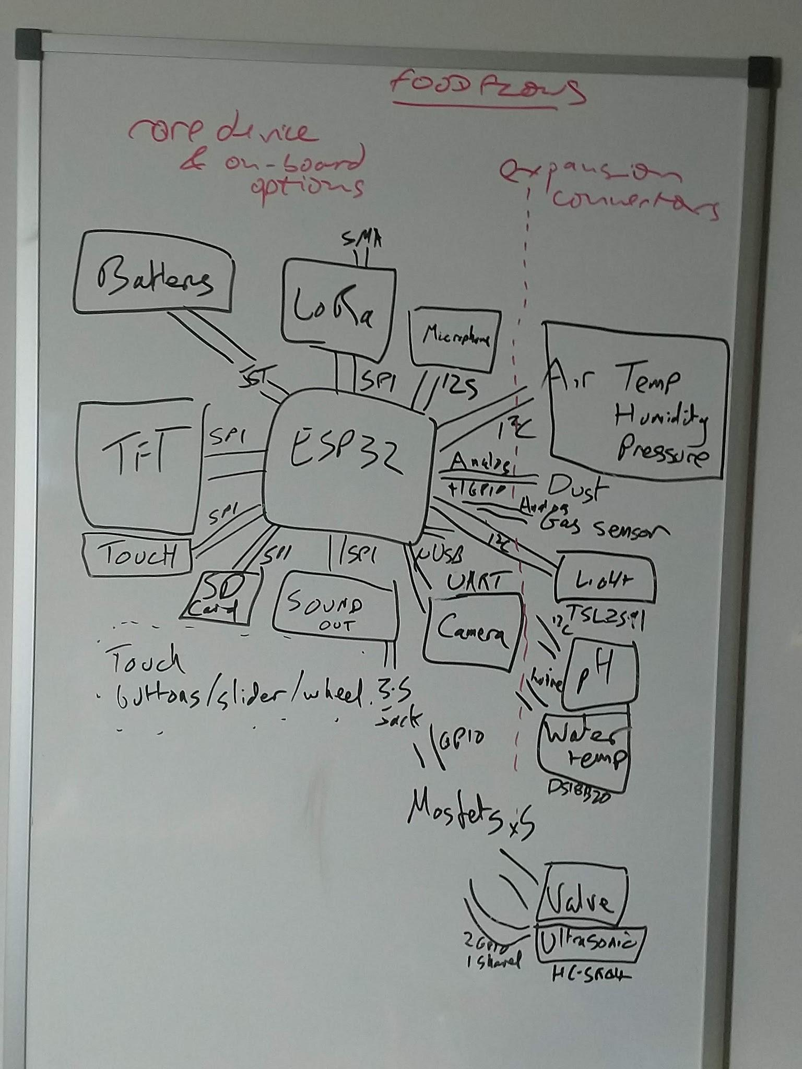
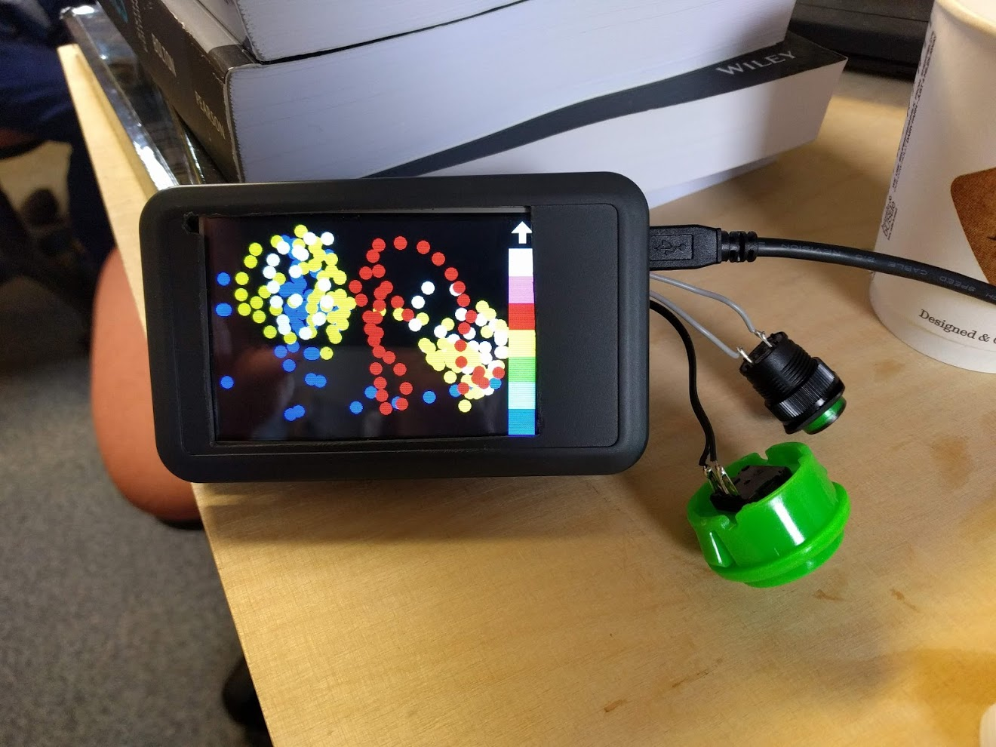
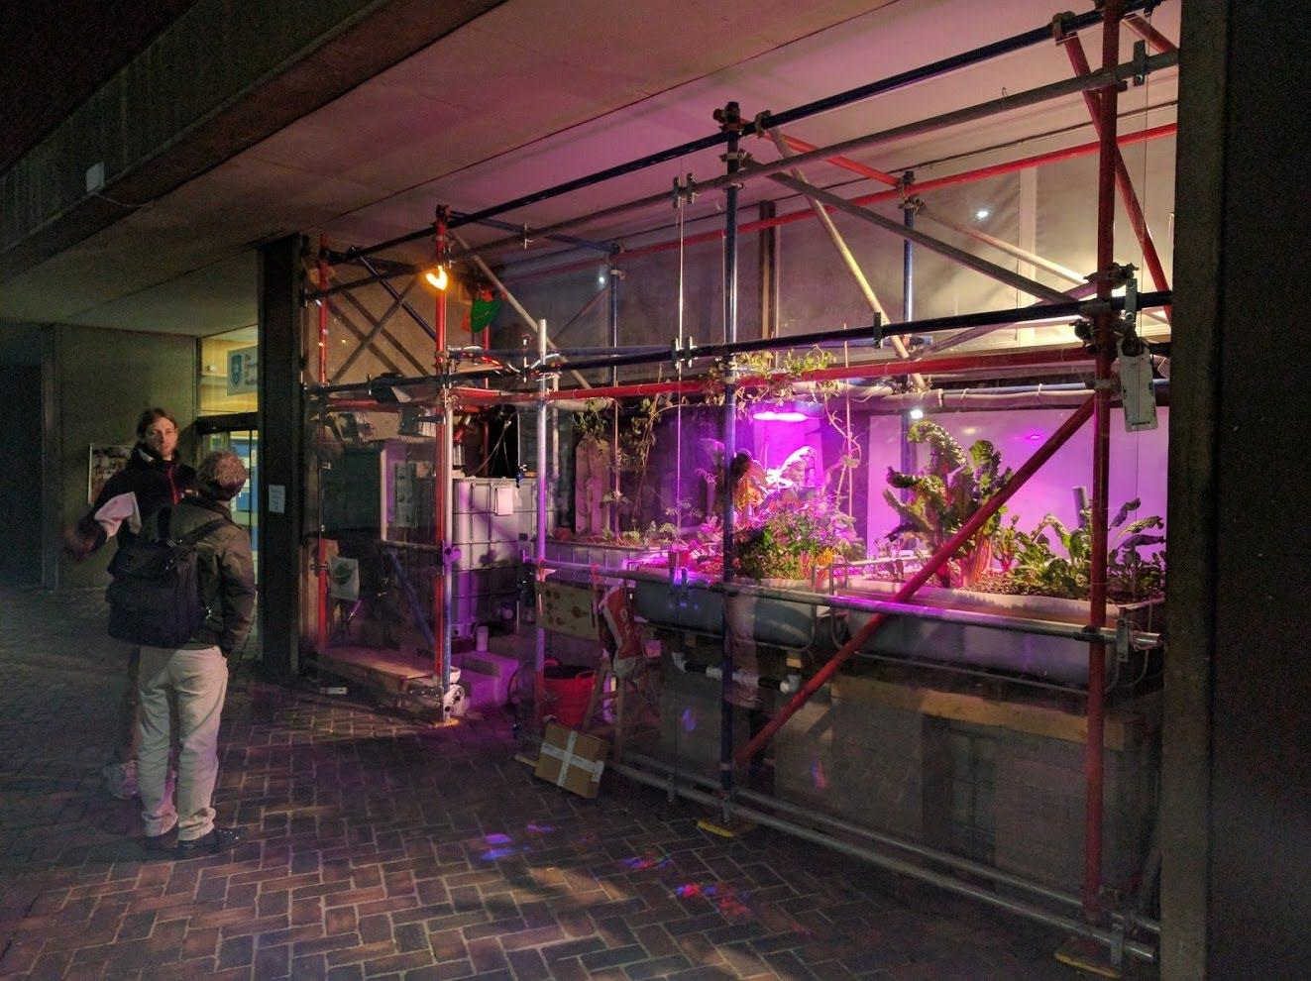
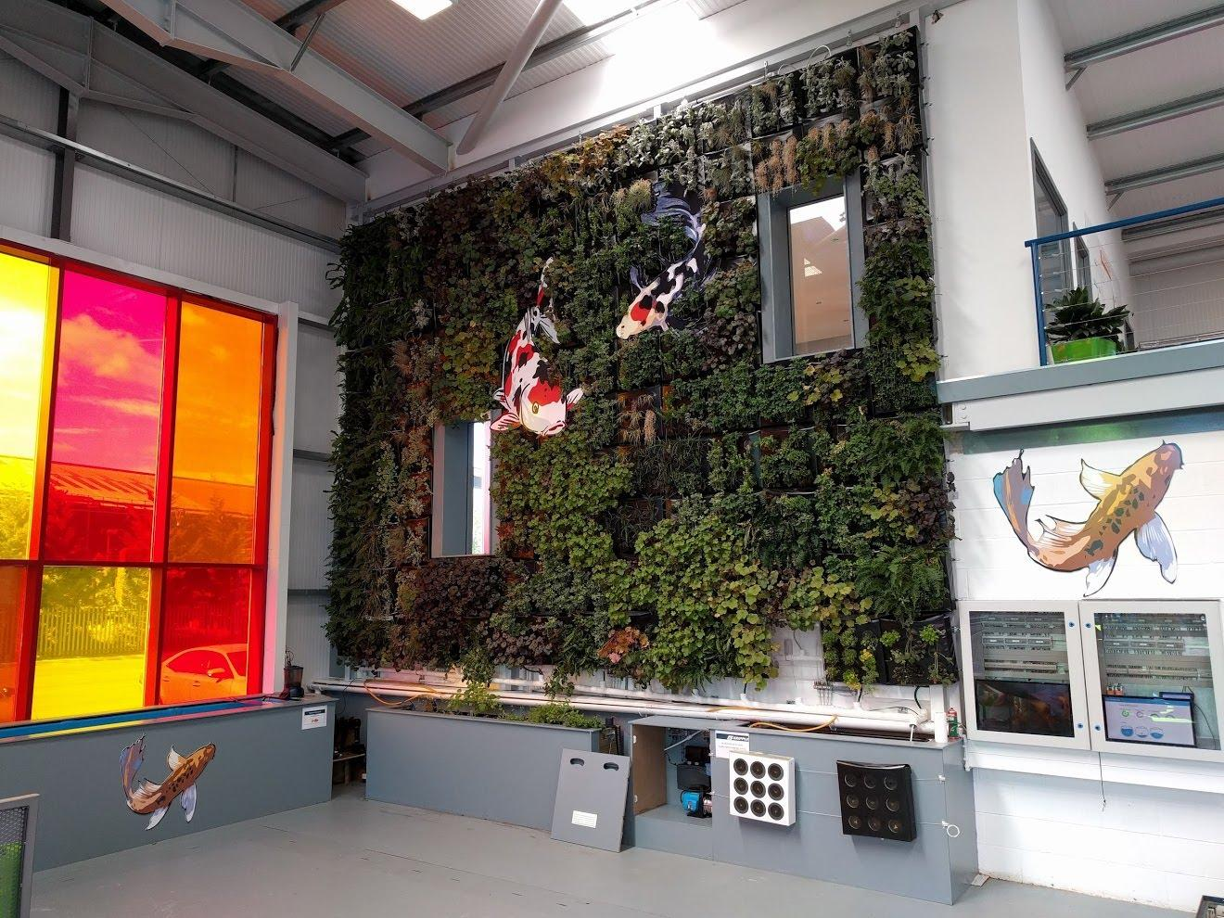
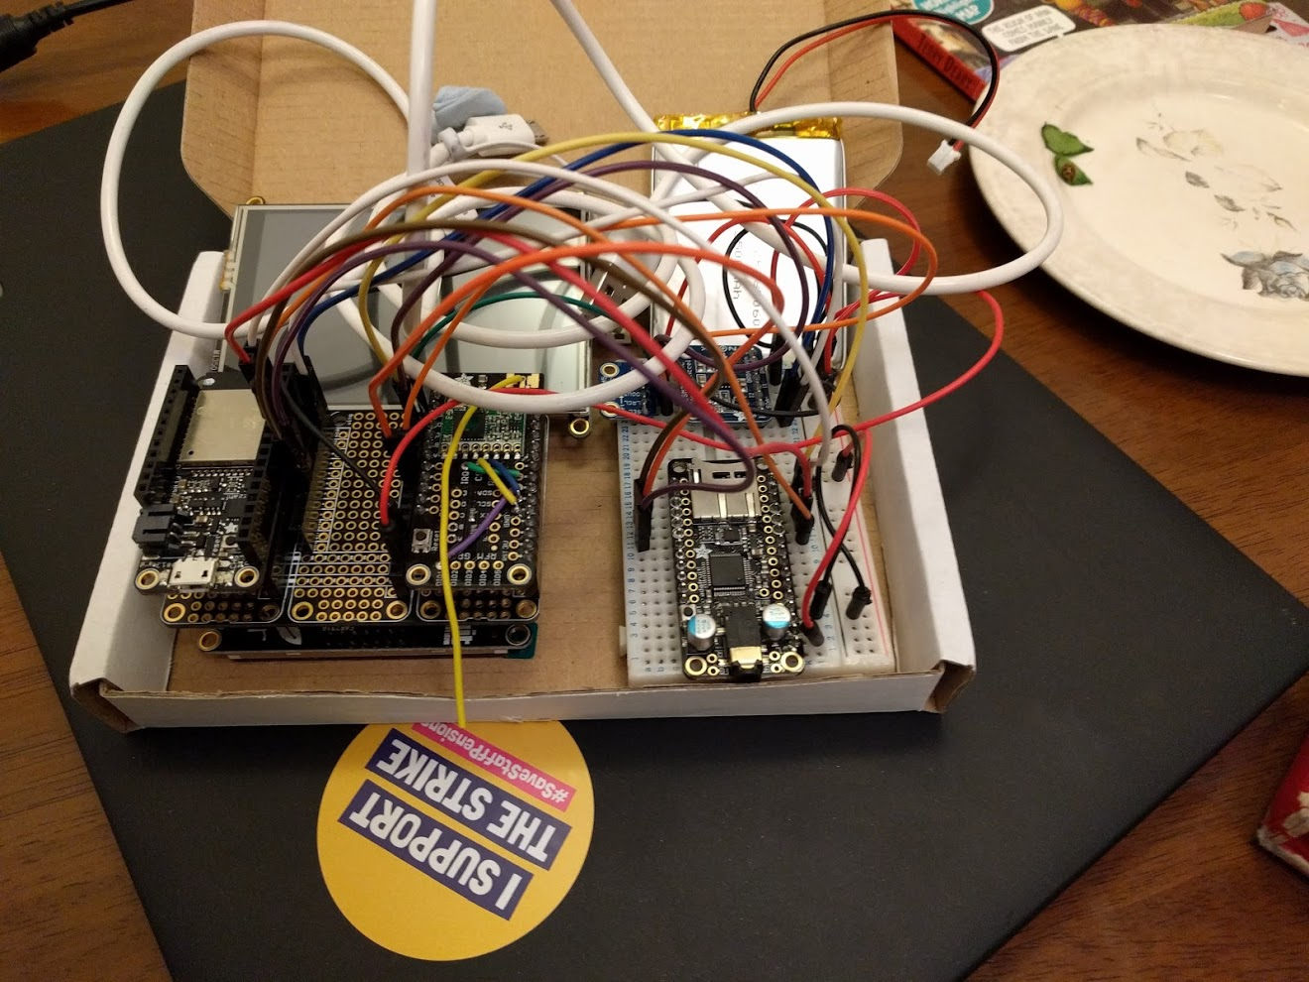
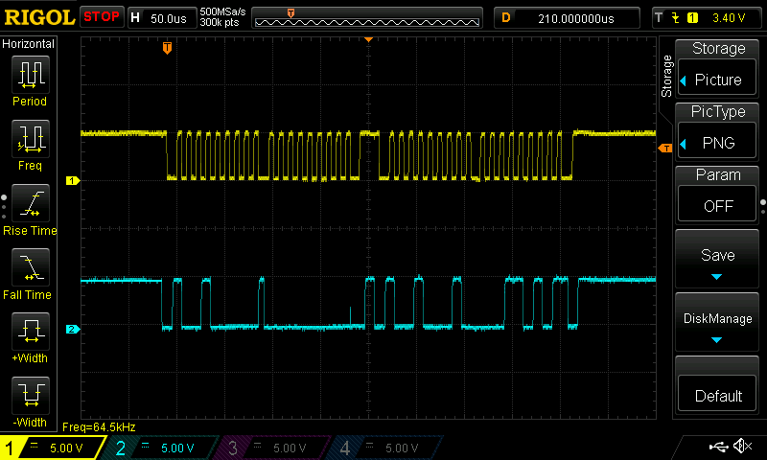
How painful…?
From this...
...to this...
...for these:
...via this...
(lots of work for this!)

Slide 17
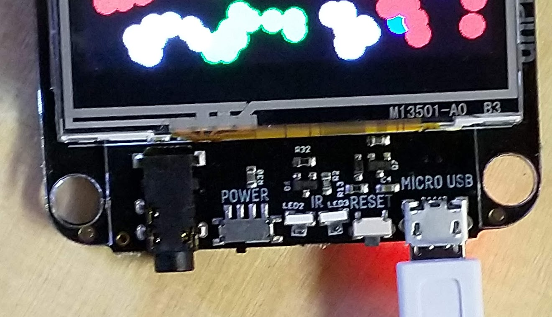
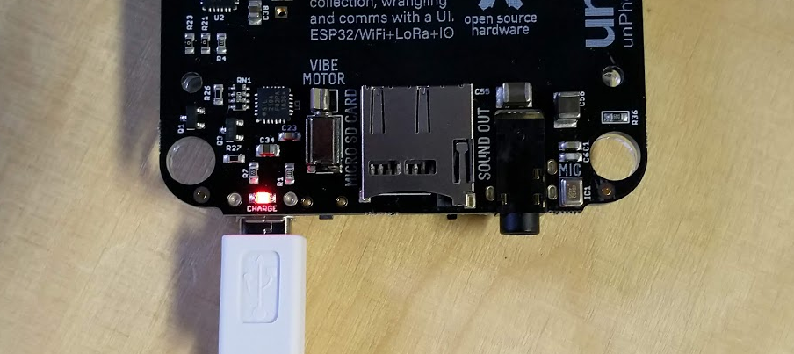
Wh…?
IR LEDs
USB power and serial (C in 7+)
headphone jack (not in 7+)
reset
<= on/off =>
vibe
SD card

Slide 18
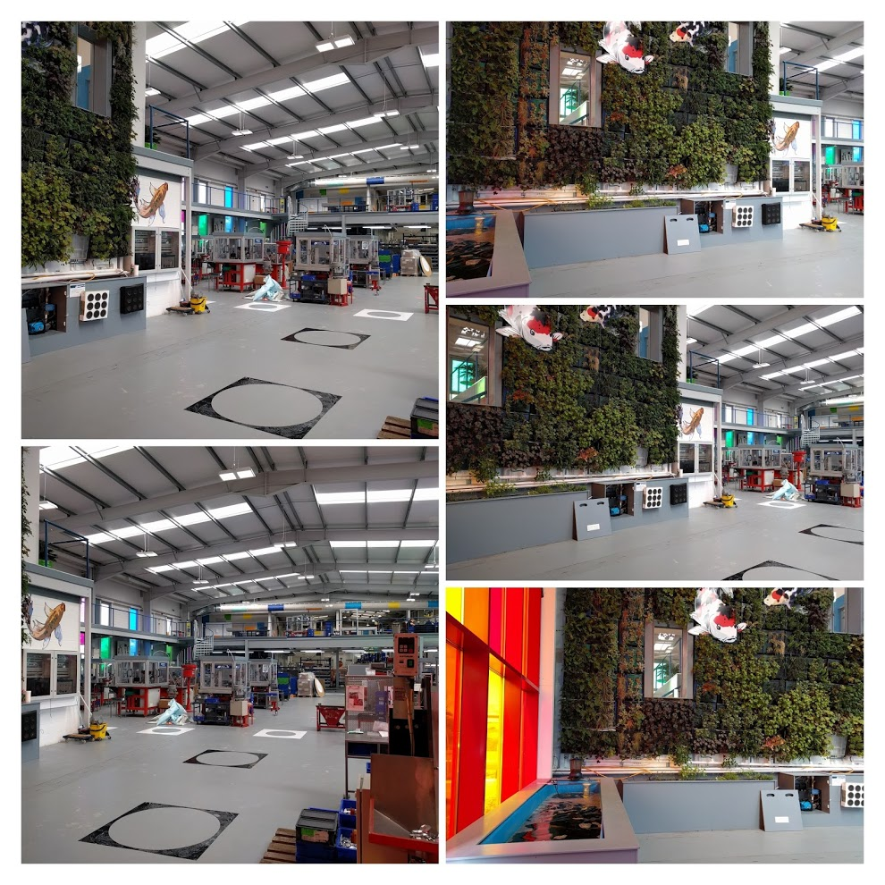
Creating a new IoT device
Stages:
breadboarding
stripboarding
testing testing testing!
no one likes a wet factory :(
proof of concept? demand?
creating a circuit board…
bringing up the board: if chip X doesn’t work, reach for the scope…
writing a firmware test harness
applications time!

Slide 19
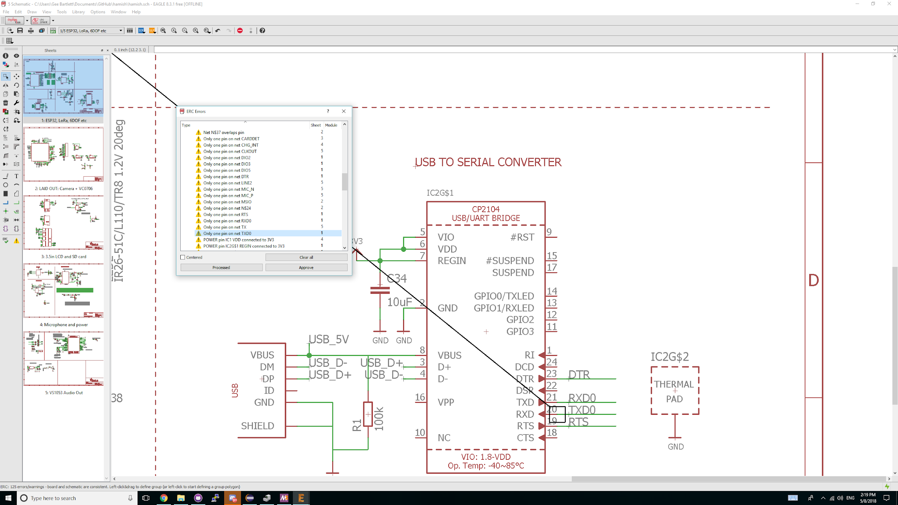
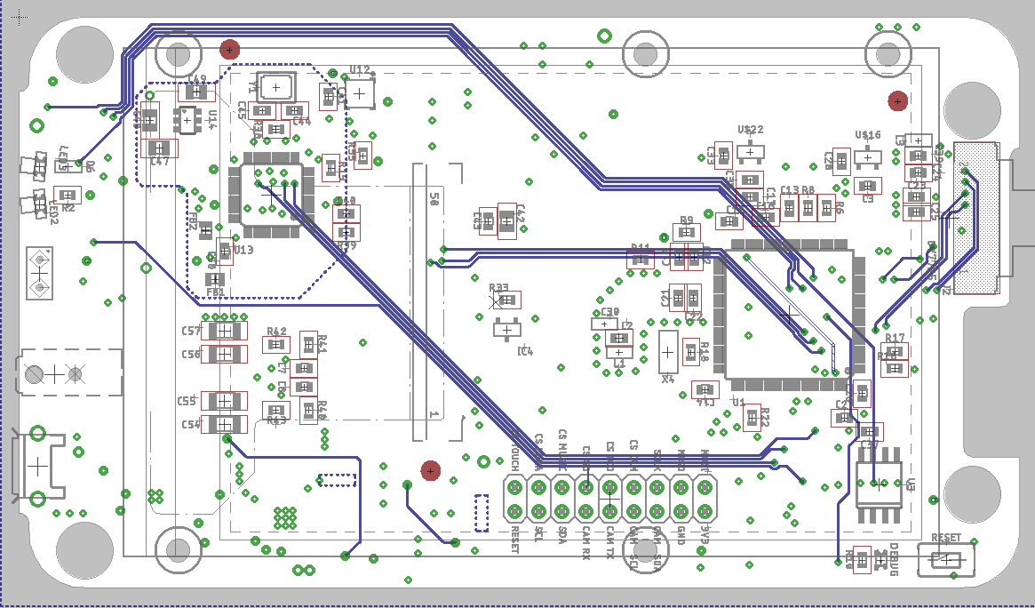
From circuit to board
Developing schematics (in Eagle, or KiCAD)
logical level circuit diagrams ==>
building on Adafruit’s open hardware designs & Gareth & Pimoroni’s expertise
PCB (printed circuit board) routing diagrams =======>
send away for PCBs and a stencil, and...

Slide 20
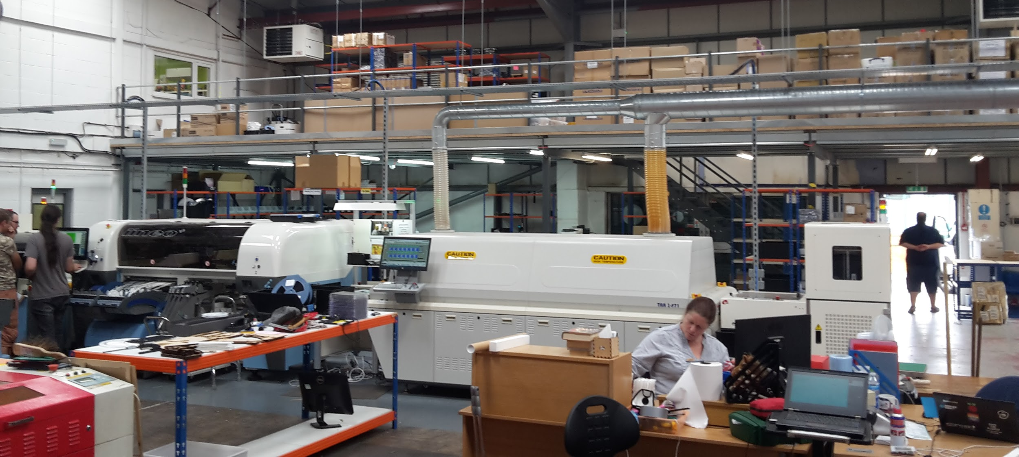
Bung it in the pick’n’place machine

Slide 21

Load in a bunch of rolls of components...

Slide 22
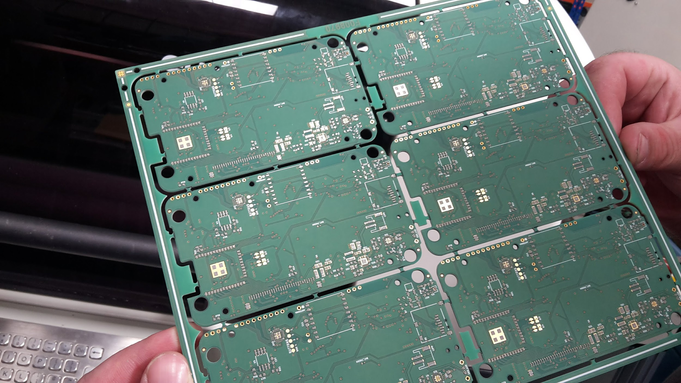
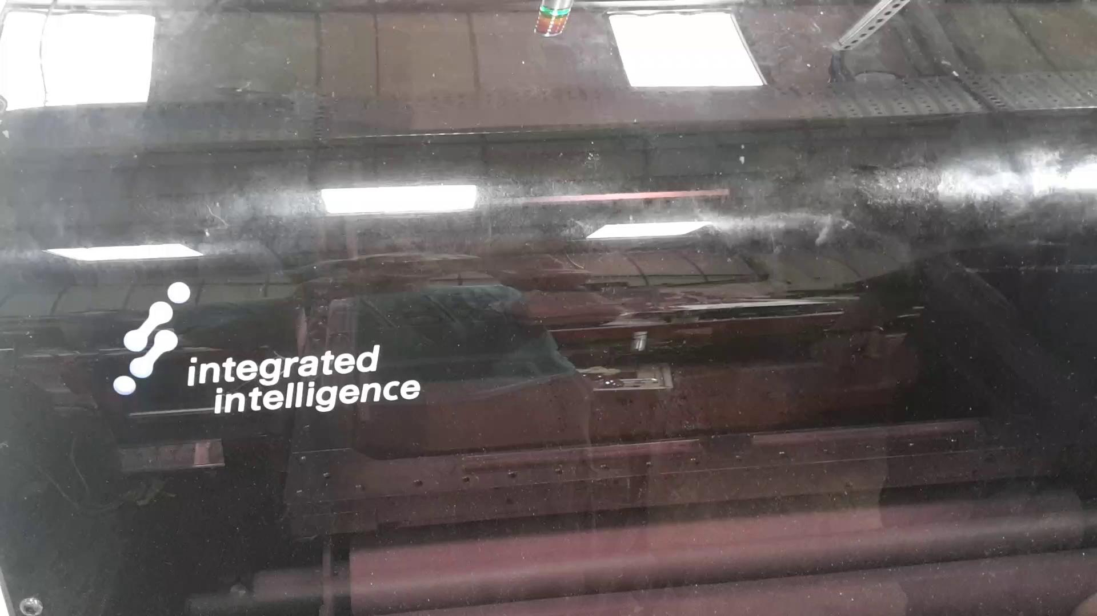
Applying solder paste to the bare board
Notes:
Although the solder paste looks like it’s just a sloppy mess actually it’s incredibly precicely controlled and each tiny metal pad on the board recieves the right ammount of solder.

Slide 23
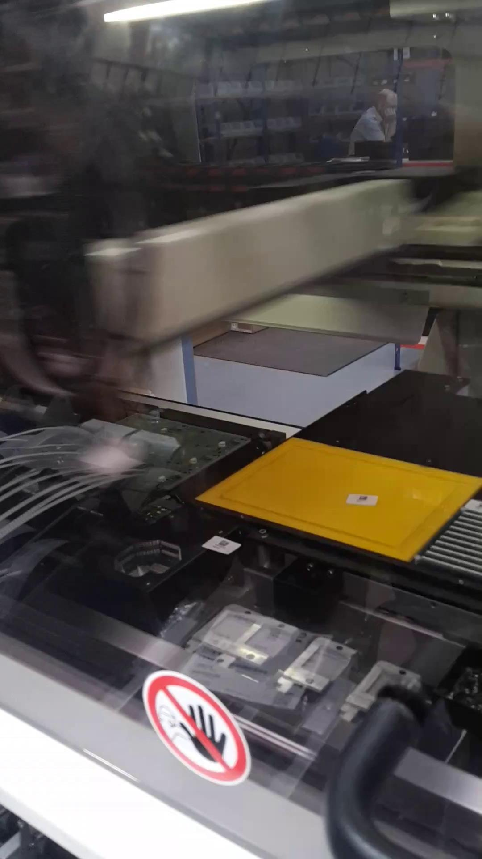
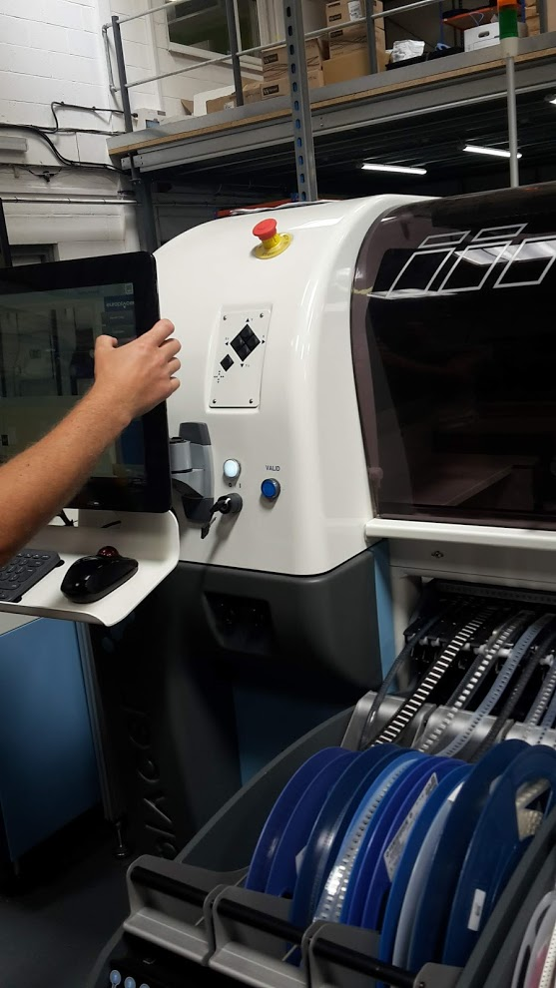
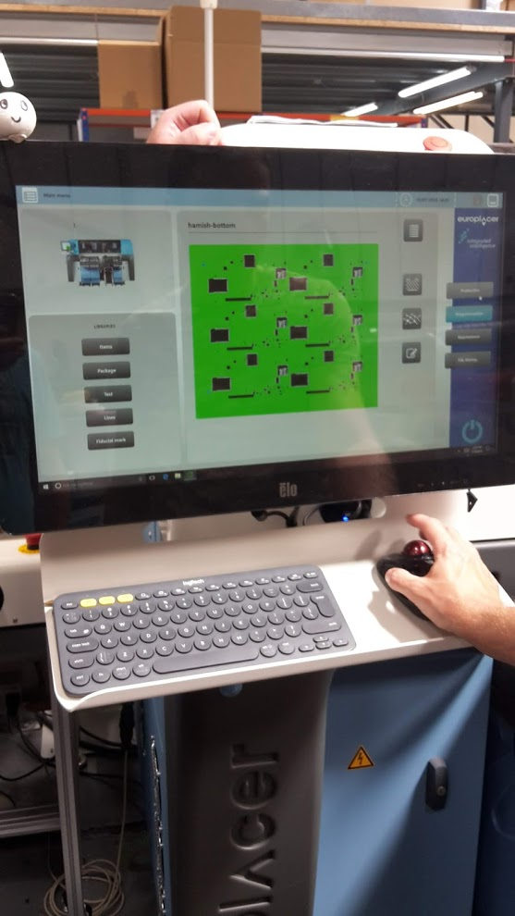
Pick and place robot
Notes:
The head of the robot arm moves at a blur - you literally can’t see it working it’s that fast...

Slide 24
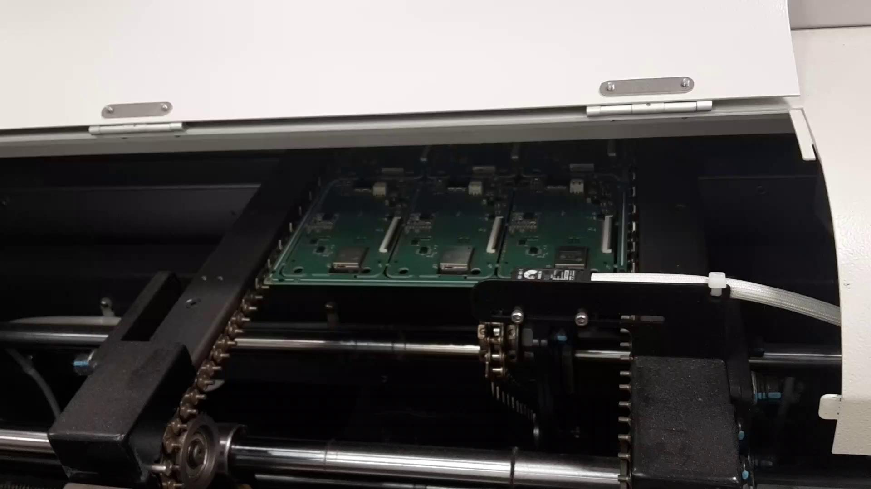
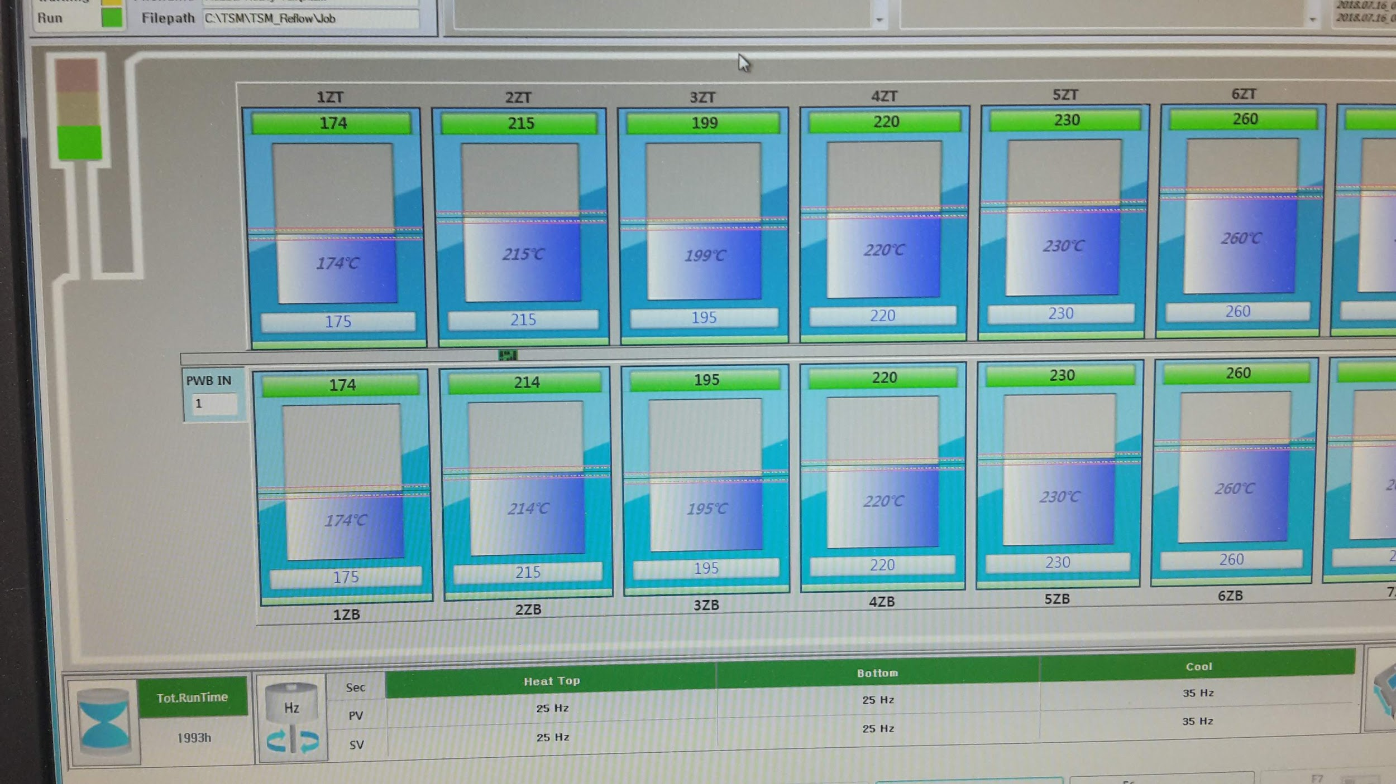
Carefully apply the hotness
Notes:
This board has a 12 step program of hotness ahead of it, as the board and every component on it gets heated up to around 250C and then down again.

Slide 25
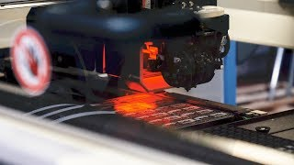
Yet more video…
Notes:
This board has a 12 step program of hotness ahead of it, as the board and every component on it gets heated up to around 250C and then down again.

Slide 26
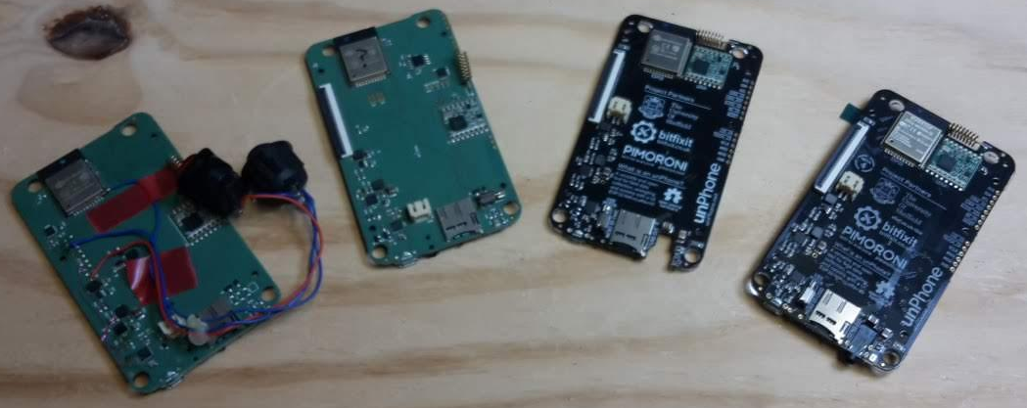
Getting it right: 9 hardware iterations
From left to right:
first pcb version (buttons are for programming and reset),
second with auto-programming,
third with new expander to handle the SPI CS (chip selects) and etc. (e.g. backlight),
and version 4 with more minor fixes; this was the first COM3505 version

Slide 27
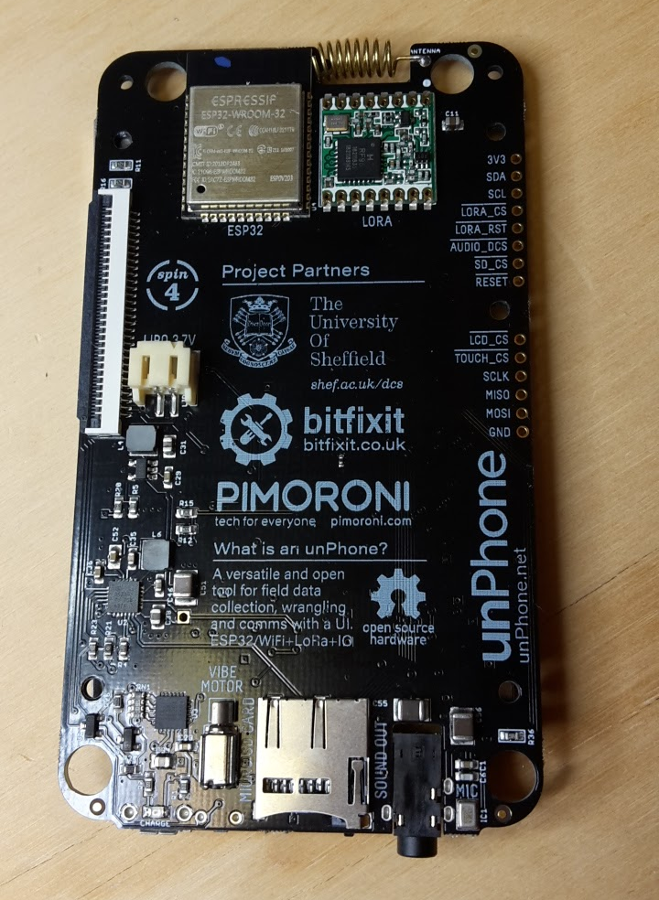
It’s a thing! (v4: 31st Jan-8th Nov 2018: 9 months proposal to delivery!)
Bringing the board up: messy!
when things don’t work as expected there’s no knowing whether it is the hardware or the code that’s at fault; lots of painful debugging with an oscilloscope!
unintended consequences: “I know, let’s add an IO expander!”
adds lots of connectivity by shunting the chip select lines of the various modules onto an expander chip (TCA9555, on I2C) :-)
means that none of the libraries work any more :-( because they use digitalWrite(PIN, HIGH) internally
so now we have an IOExpander class that we inject into libs: #include "IOExpander.h" #define digitalWrite IOExpander::digitalWrite #define pinMode IOExpander::pinMode #define digitalRead IOExpander::digitalRead
the overridden methods use bit 2 of the PIN int to signal an unPhone pin (why not the top bit? casts from uint to int make it -ve!)
void IOExpander::digitalWrite(uint8_t pin, uint8_t value) { if(pin & 0x40) { pin &= 0b10111111; // mask out the high bit IOExpander::writeRegisterWord(0x02, new_output_states); // trigger 9555
good news: we dropped the IOExpander for most things in Spin 9!

Slide 28
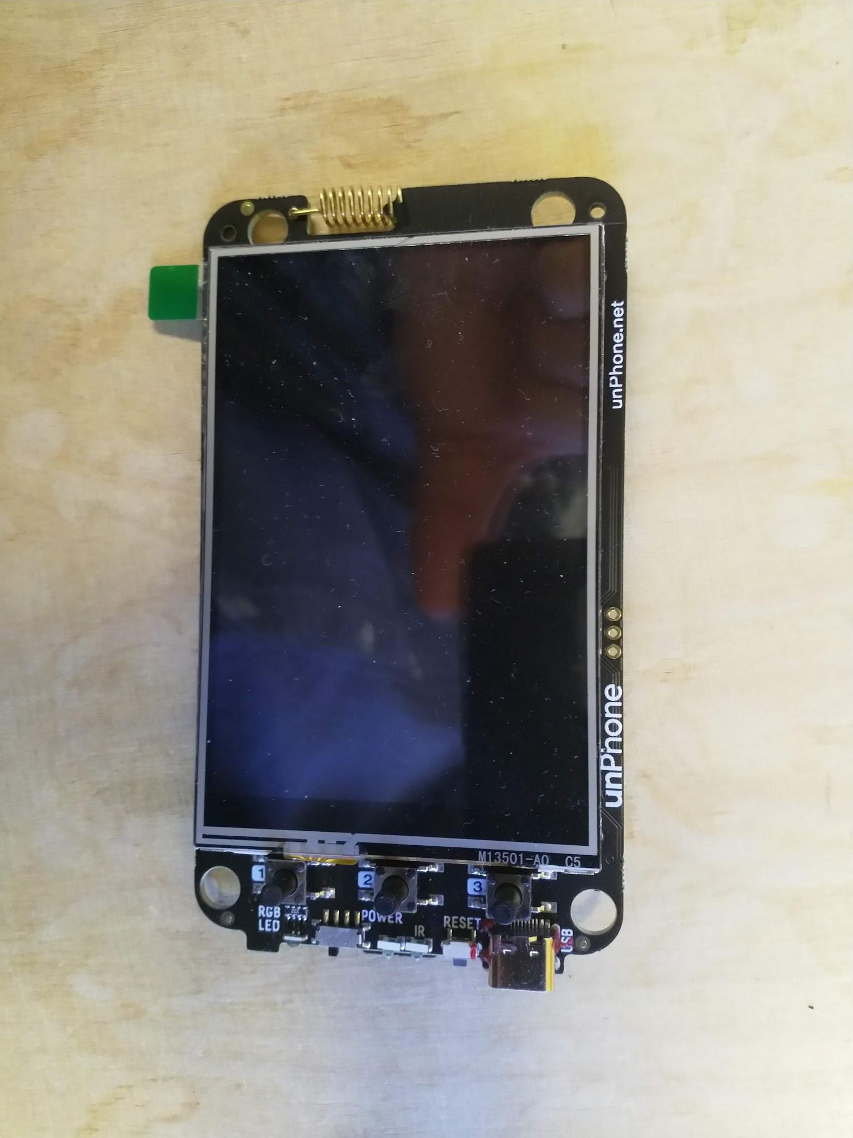
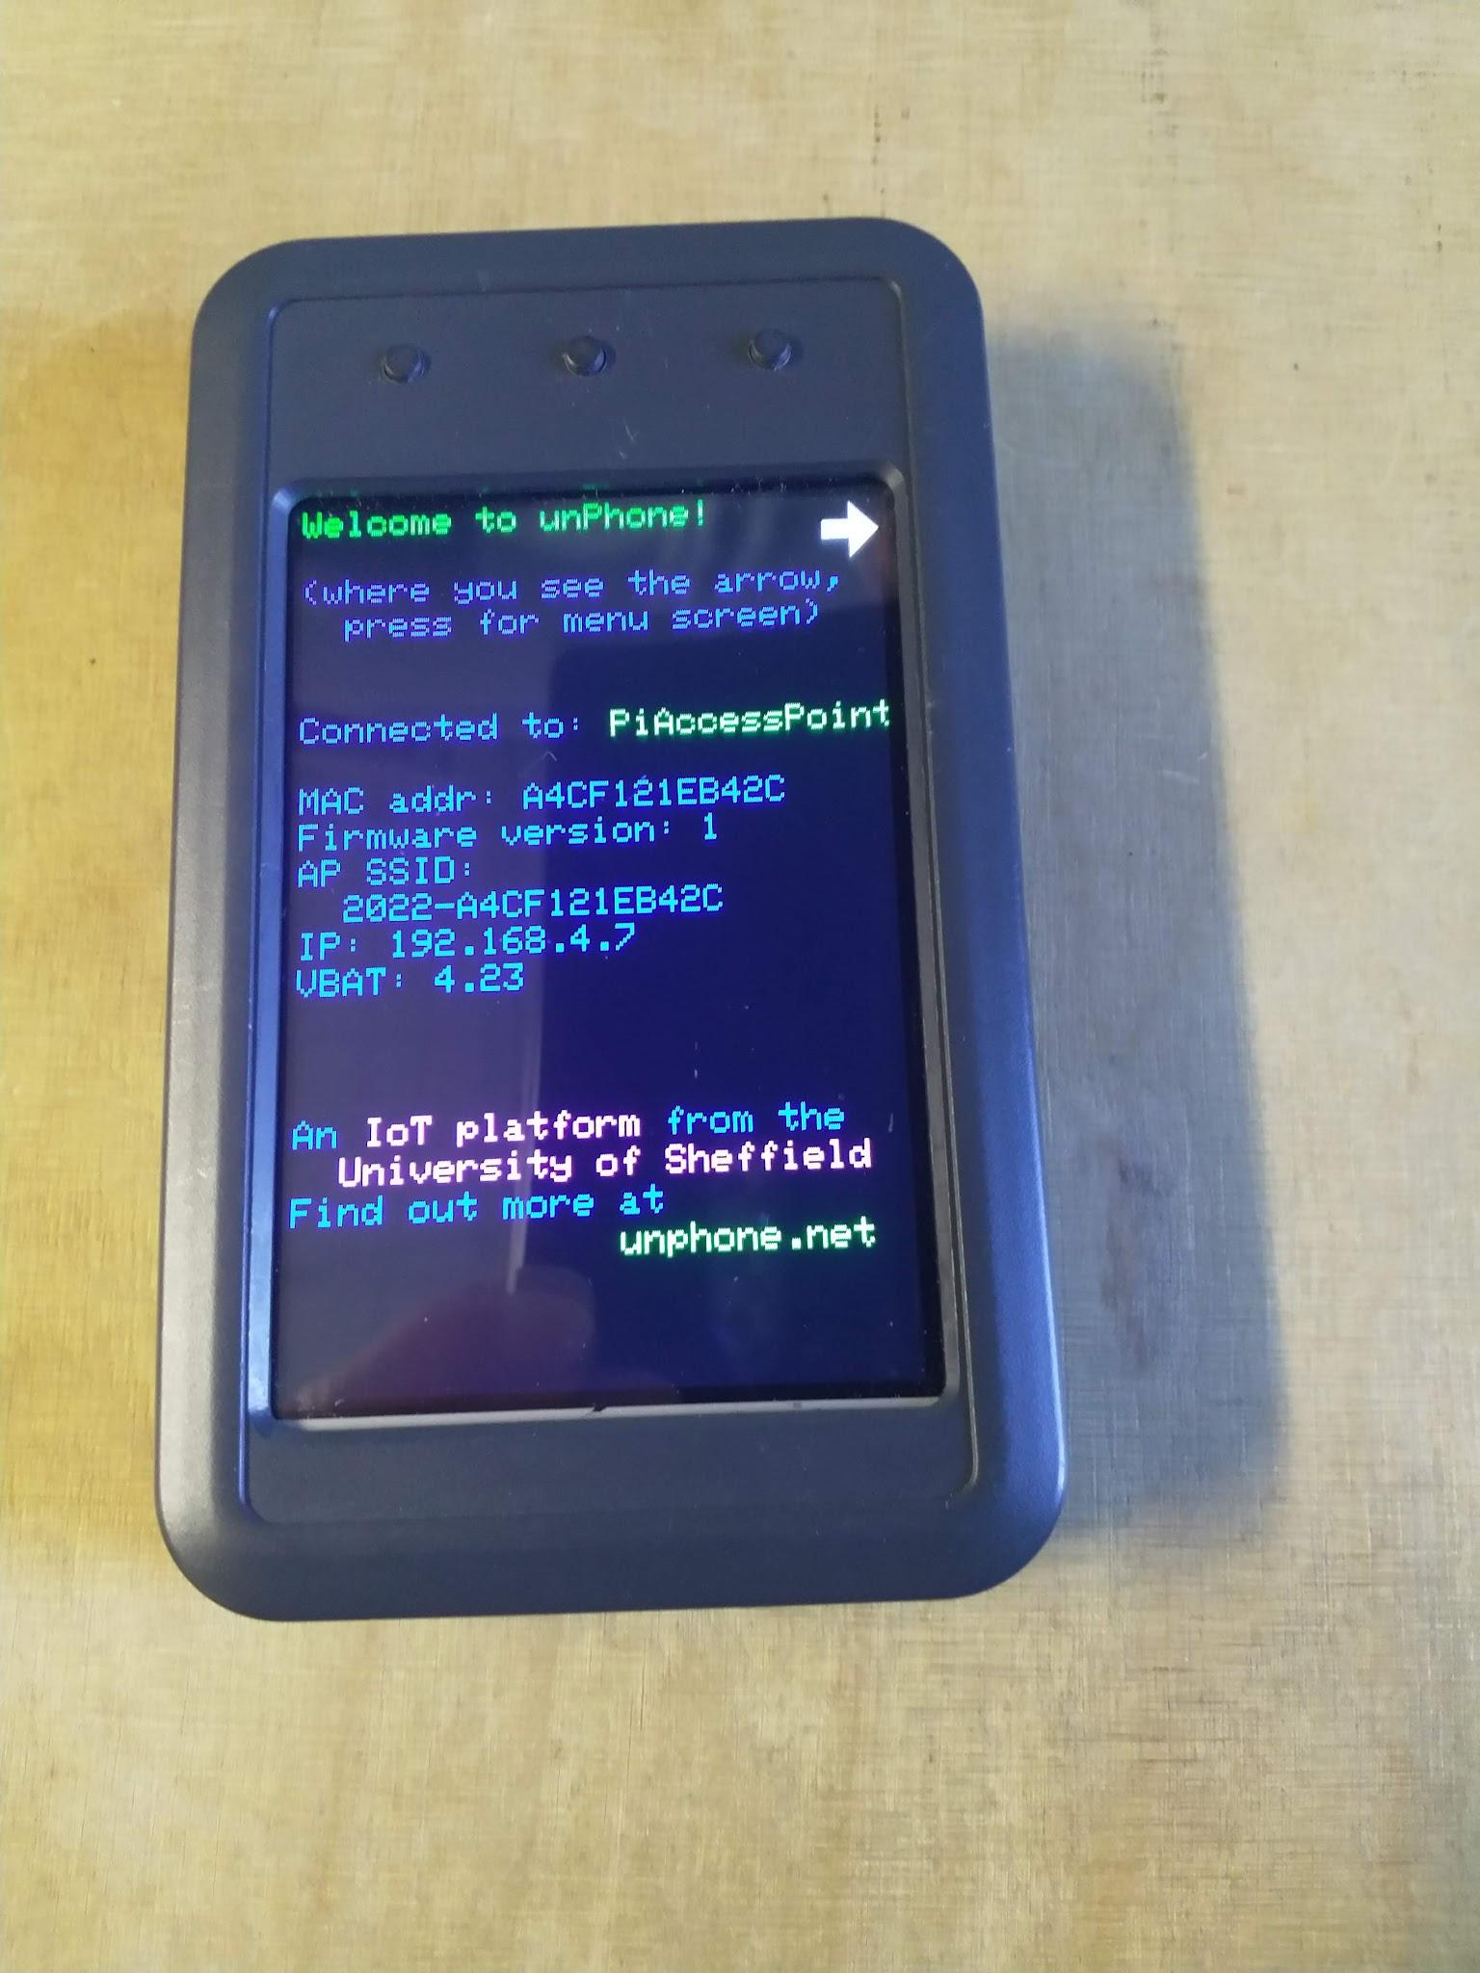
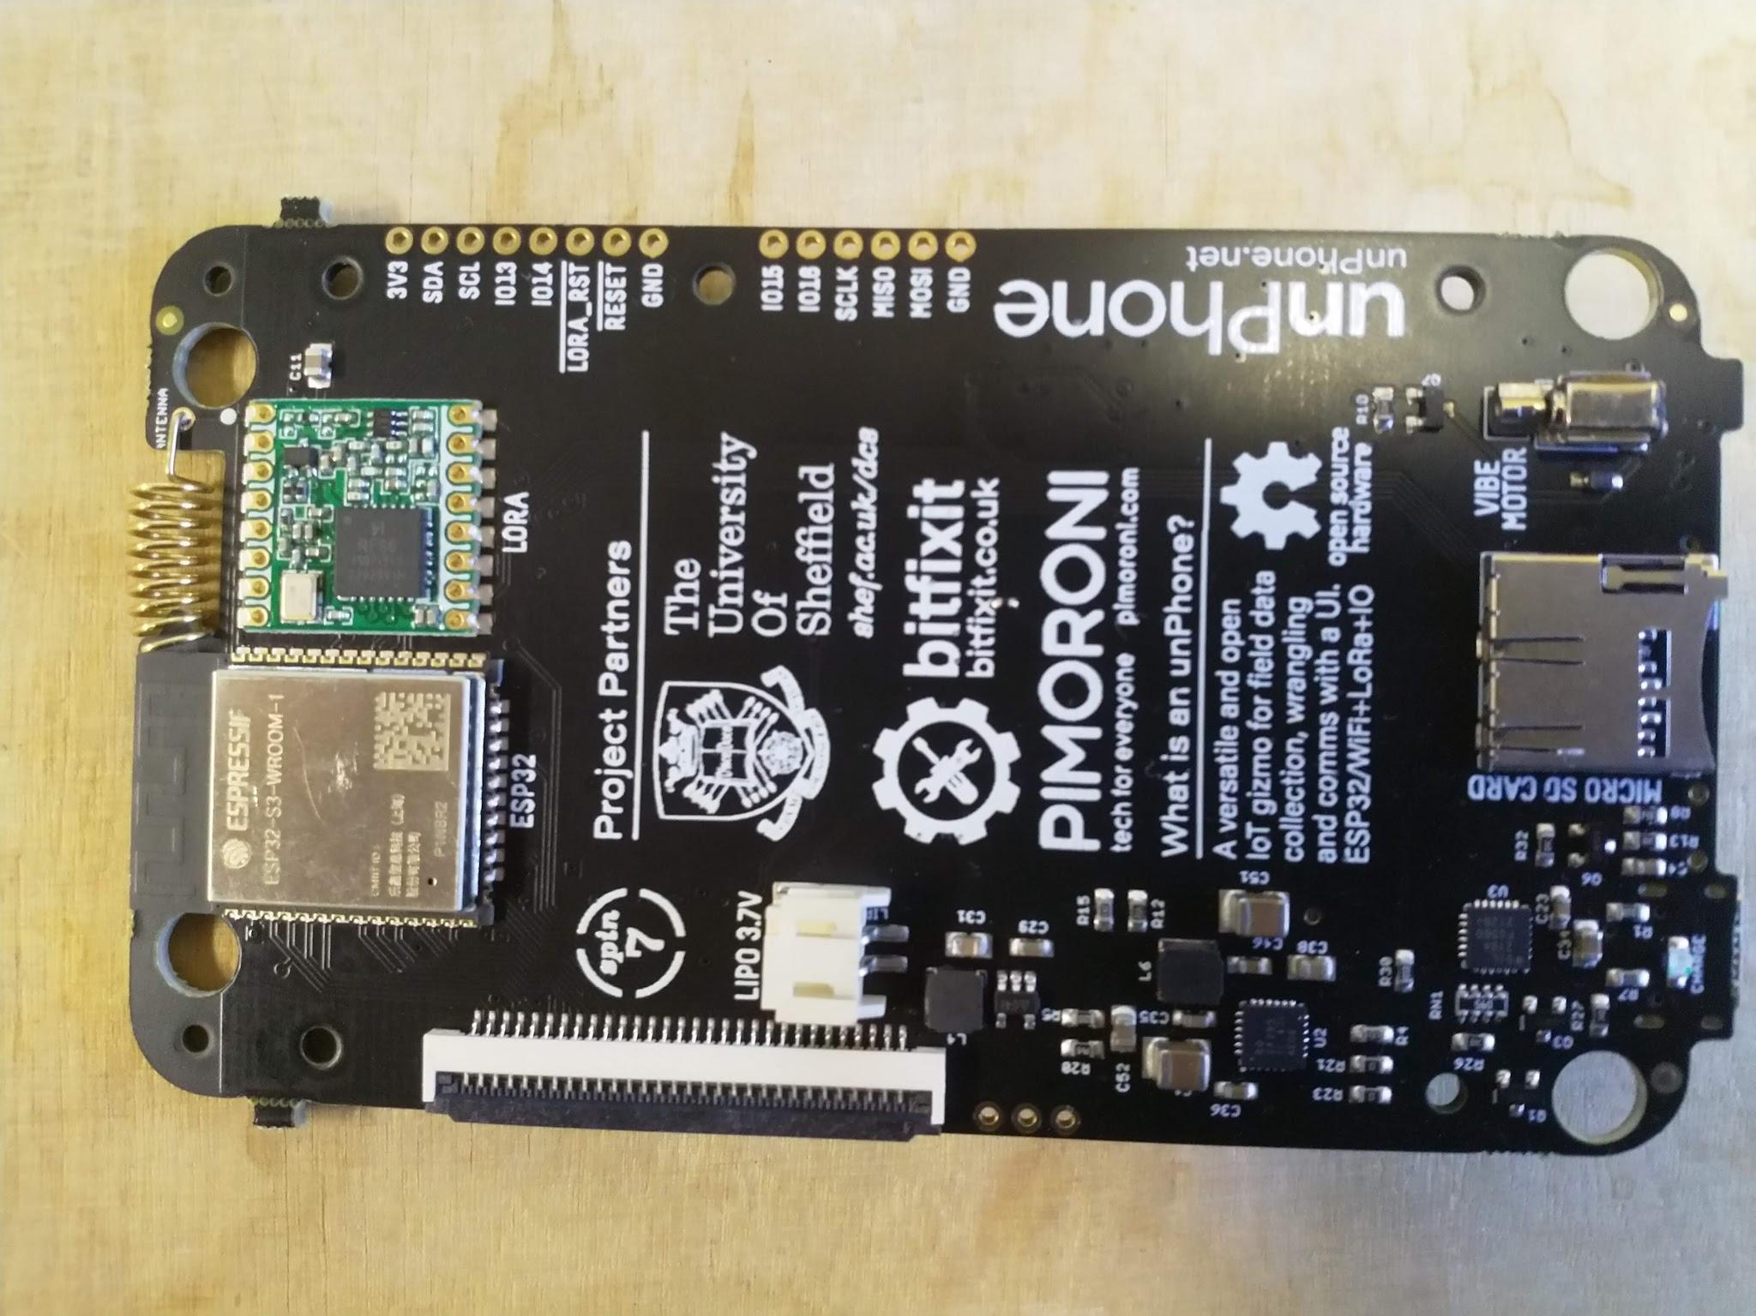
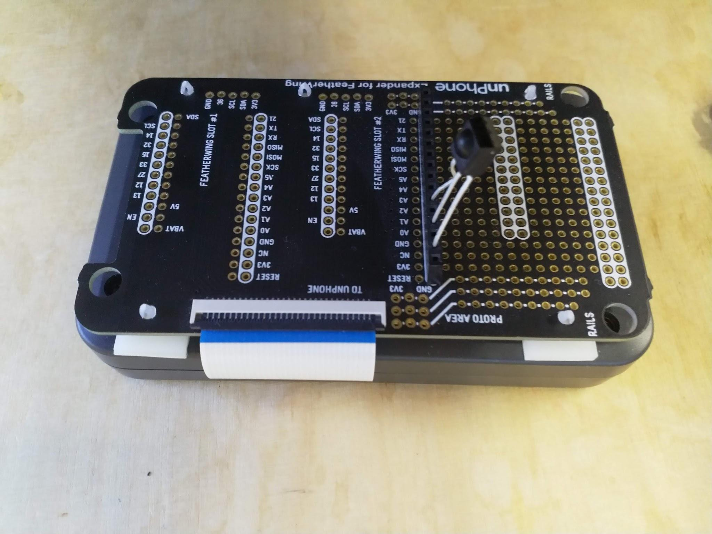
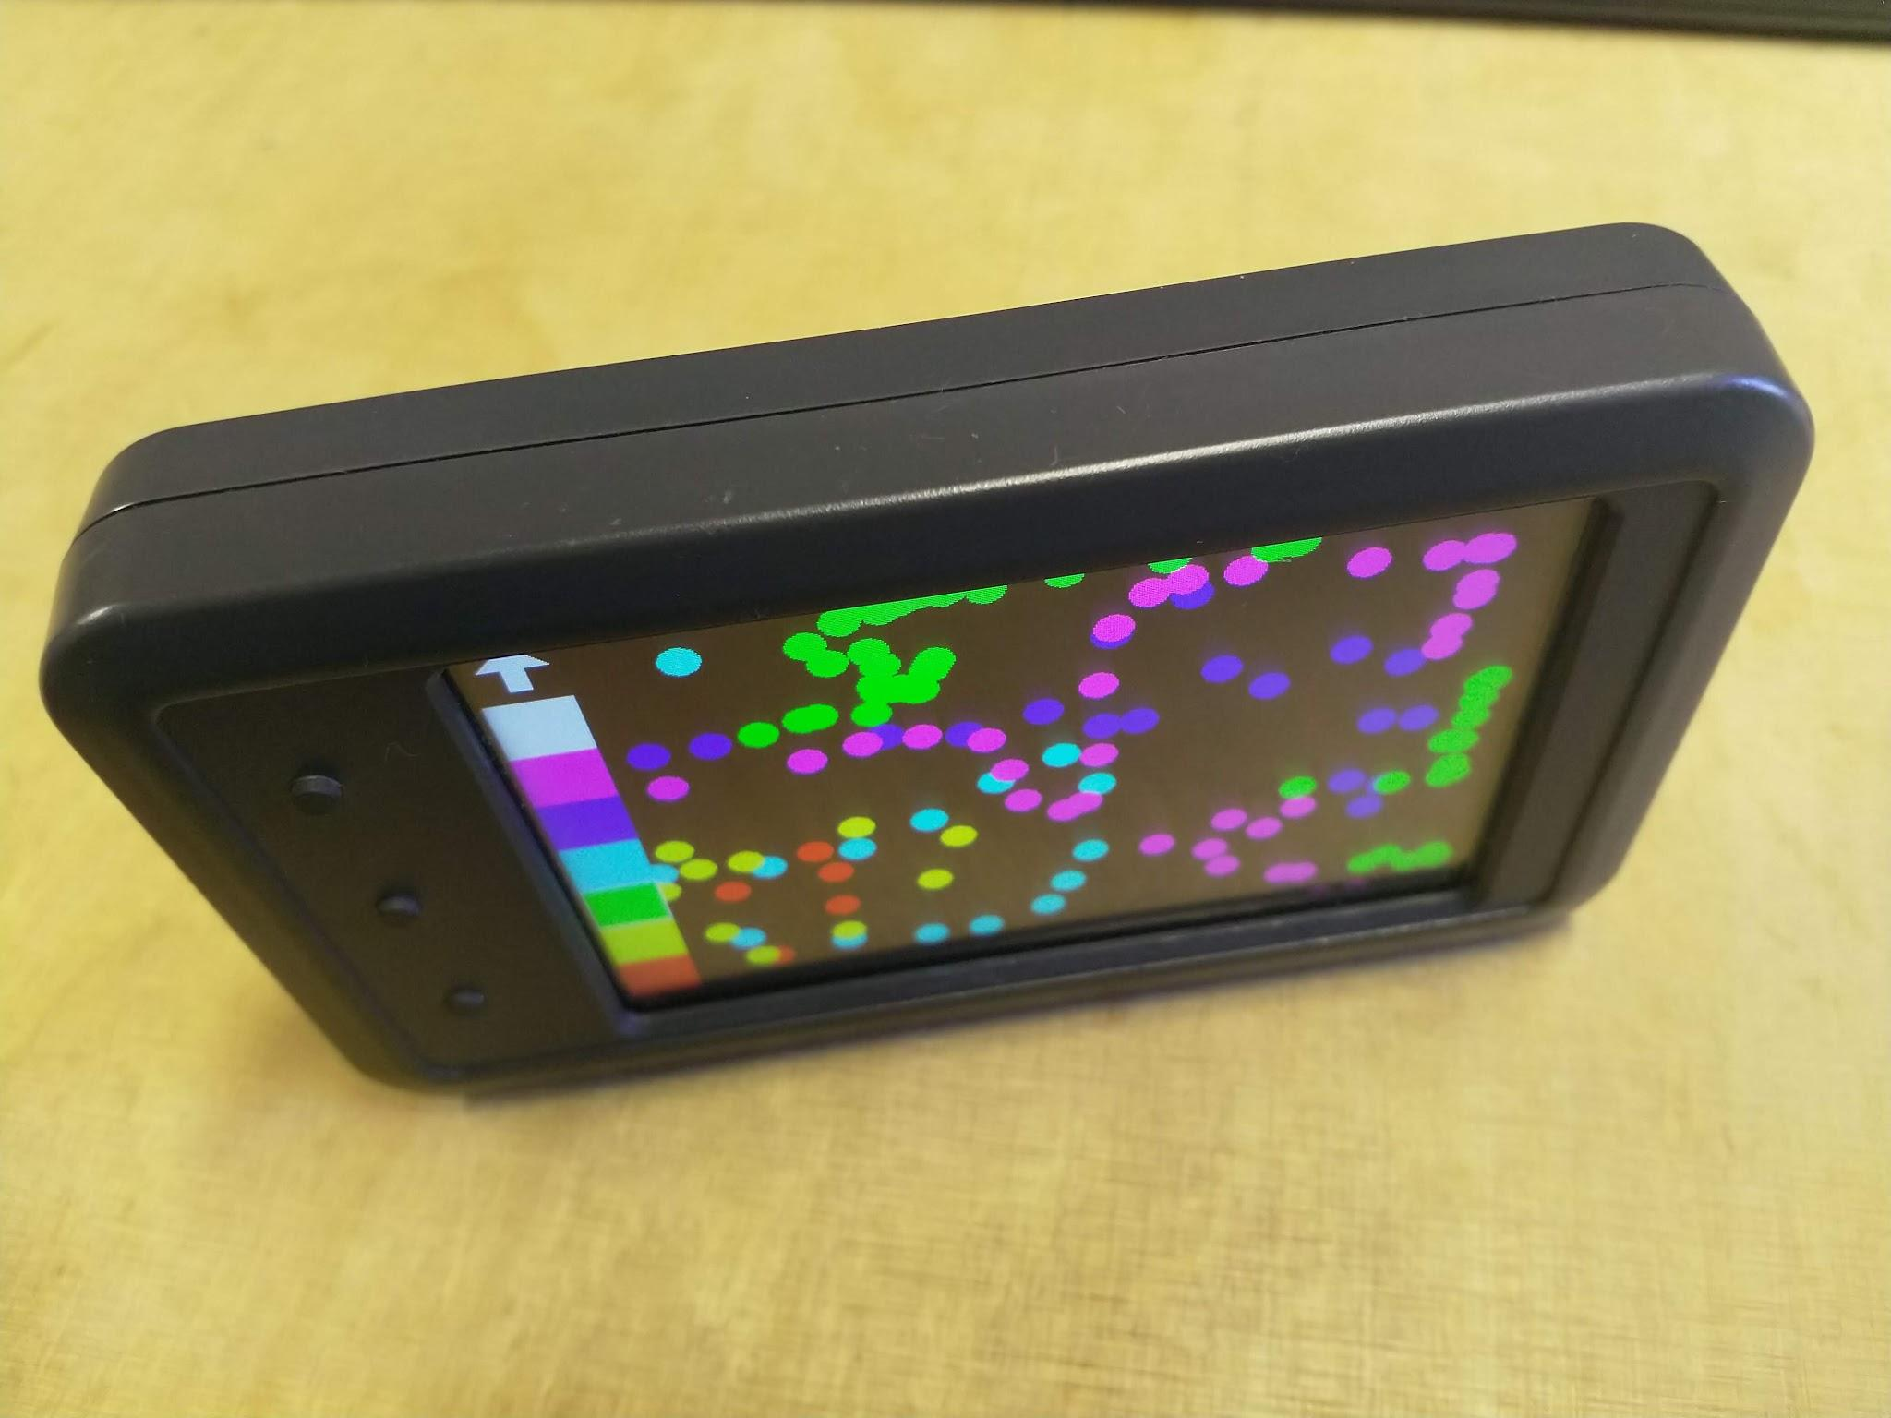
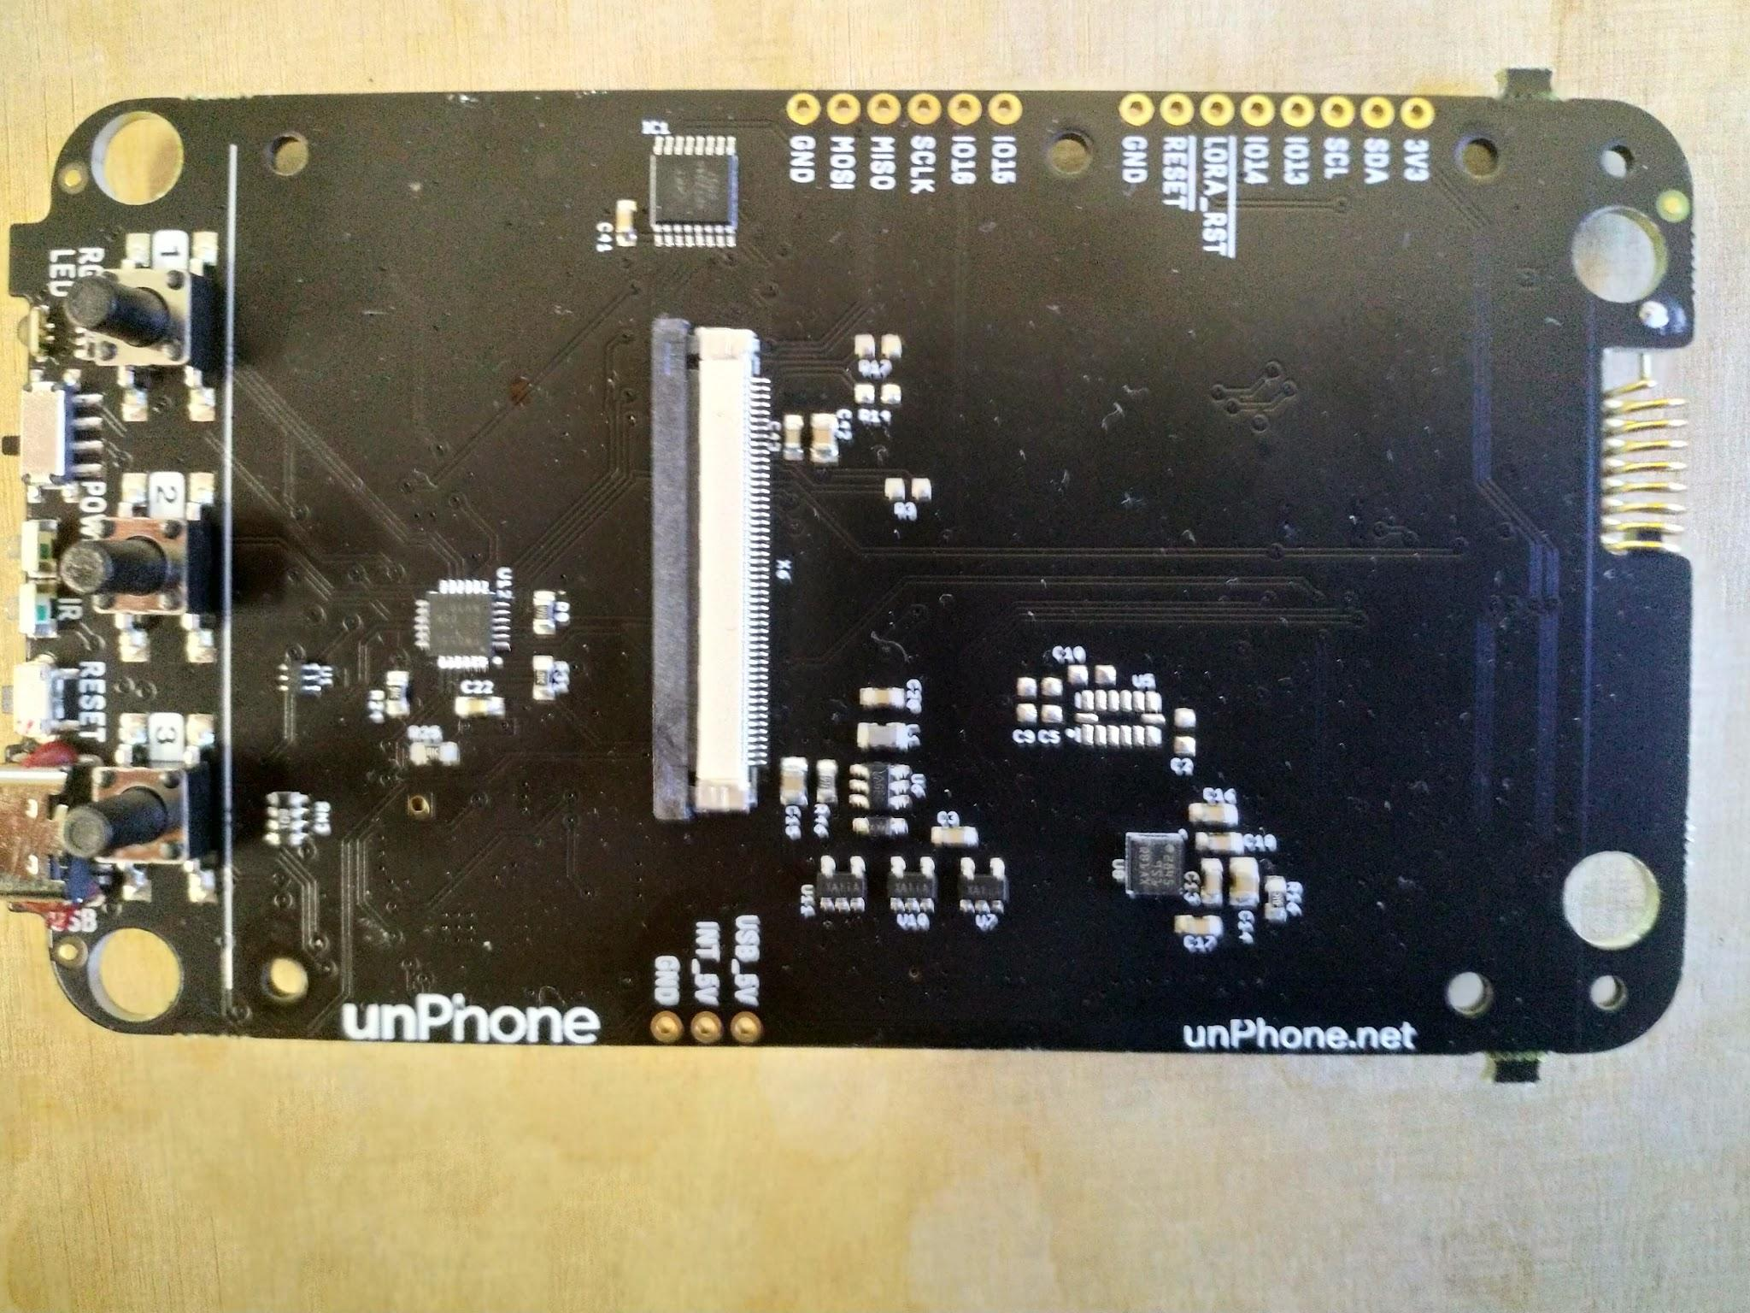
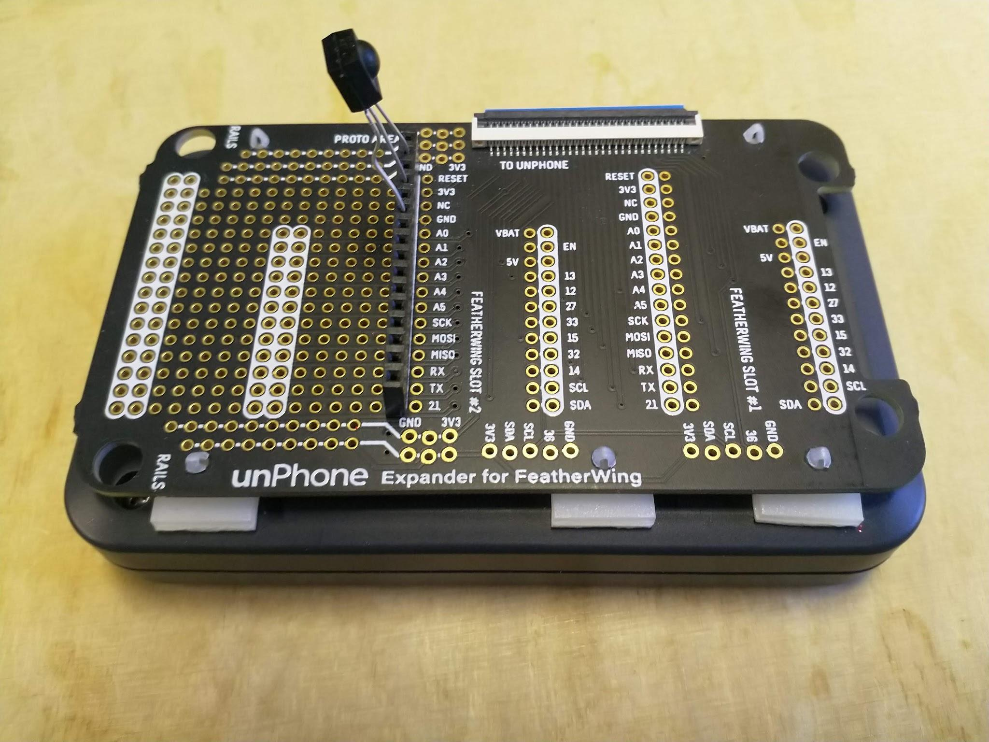
It’s a product?
Spin 9 is due for retail release in 2023… and um, now actually being released :)

Slide 29
IoT device gestation: big, but getting smaller
+ves
from original idea to working system took less than a year
budget was tiny in comparison to traditional product development
we learned a lot! (hopefully we’re managing to share some of that with you!)
-ves
pandemic ⇒ chip shortages; then post-pandemic, chip hoarding as strategy :(
lots of unforeseen hiccups and unintended consequences
the pace of change is challenging: “don’t look now, your synthesiser has just gone out of date”
“always start from a known good”... um, except when there isn’t one?!
the more libraries you use, the more unstable your development environment

Slide 30
Your TODO list for week 7:
Do the assessment
Come to the lab on Wednesday
the GTAs won’t do your assessment for you :(
but the assessment is based on the exercises and the notes, and they can answer questions about those :)
Pick up project hardware if you want to start before week 8…

